Slide 1

Challenges of e-Government Innovation Initiatives in Public Administration of Bangladesh

Slide 2

What is e-Government?
E-government refers to a situation where government bodies and agencies are automated and interconnected through ICTs.
What is Innovation?
Innovation refers to the introduction and implementation of new ideas, practices, processes, technologies, or approaches to improve the effectiveness, efficiency, and responsiveness of government operations and services.

Slide 3

Present Status of e-Government
Availability of online forms
Online Birth Registration System
Digital One-Stop Services
National Web Portal
Automation of Internal Processes

Slide 4
e-Government Related Innovations in Bangladesh
01
02
03
04
05
Digital Bangladesh
Biometric ID
System
Union Digital Centre
Mobile Helpdesk
National Web Portal

Slide 5
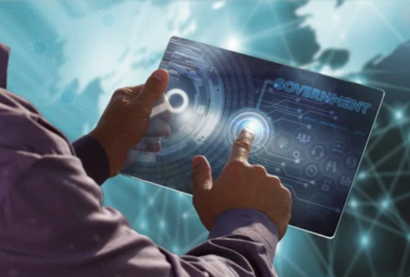
e-Government Related Innovations in Bangladesh
Mobile Apps
E-Ticketing
E-Voting
E-Passport

Slide 6

Challenges of e-Government Initiatives
Lack of IT infrastructure
Lack of accountability and Transparency
Political Corruption
Bureaucratic Corruption
Illiteracy and lack of education
Inequality and social Instability
Bureaucratic Complexity

Slide 7

Recommendations to Overcome the Challenges
Building and developing ICT infrastructure throughout the Government.
Creating incentive structure for use of IT.
Providing networked computers.
To build sustainable models for e-government.
Initiate and develop data warehouse in all Ministry/Division/Department.

Slide 8
Recommendations to Overcome the Challenges
To launch and ensure wide participation of existing staff in computer literacy programs.
Set up and facilitate specific communication network for the government sectors.
Political and administrative leaders should take these probable recommendations..

Slide 9
Recommendations to Overcome the Challenges
Digital Infrastructure Development
Capacity Building and Digital Literacy.
Data Security and Privacy..

Slide 10


